Slide 1

Renewable Energy Plant Performance
A guided walkthrough of generation, revenue and downtime across our wind, solar and hybrid plants
Source: Power BI dashboard · figures read from the dashboard visuals
Notes:
This deck walks through the Renewable Energy Plant Performance Dashboard: what each visual shows, what the numbers say, and what we should do next.

Slide 2



The business at a glance
1.27M
₹6.32bn
₹6.31bn
3.64K
Energy generated
MWh, 2024–2026
Revenue
Sum of RevenueINR
Operating profit
Sum of OperatingProfitINR
Downtime hours
Across all plants
What the totals imply
≈ ₹4,980
revenue earned per MWh generated
≈ 99.8%
operating profit as a share of revenue
≈ 2.9 hrs
downtime per 1,000 MWh generated
Notes:
Four headline KPIs sit across the top of the dashboard. Dividing them gives useful ratios: roughly ₹4,980 revenue per MWh, an operating margin close to 100%, and about 2.9 downtime hours per 1,000 MWh. The near-100% margin is unusual and worth validating - see the final slides.

Slide 3
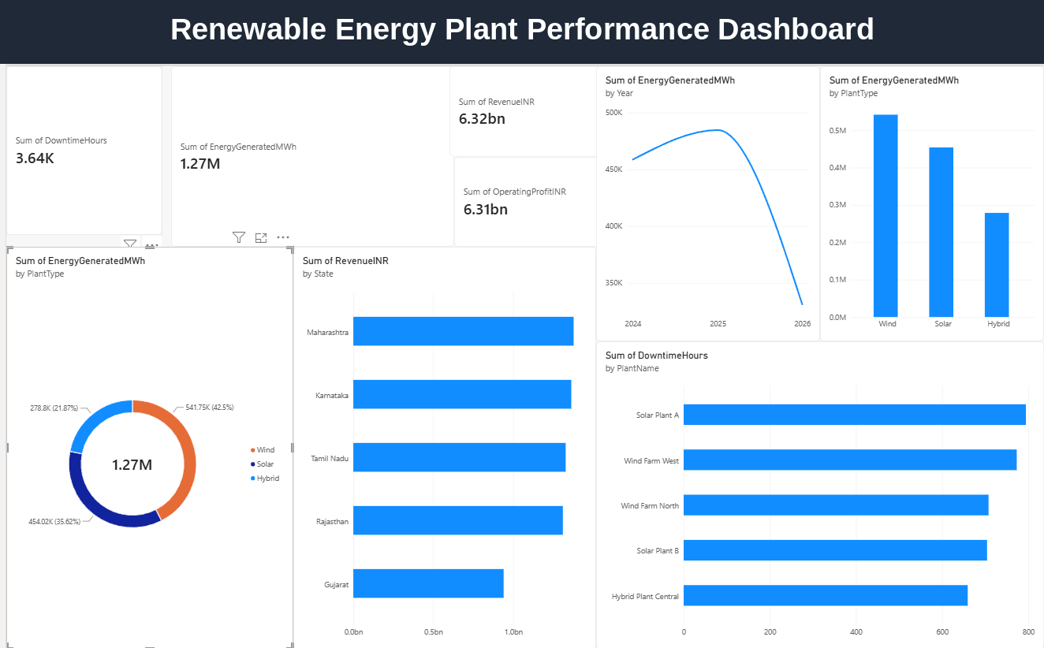
How the dashboard is organised
1
Top: KPI cards
Downtime, energy, revenue and operating profit totals.
2
Left: donut
Energy share by plant type (wind, solar, hybrid).
3
Centre: bars
Revenue ranked by state.
4
Right: trend and plants
Energy by year and type; downtime by plant.
Notes:
Orientation slide. KPIs on top for the headline numbers, then each chart answers a single question: which plant type, which state, which year, which plant has the most downtime.

Slide 4
Wind leads generation with a 42.5% share
Wind: 541.75K MWh
The largest contributor at 42.5% of all energy generated.
Solar: 454.02K MWh
35.6% share – about 88K MWh behind wind.
Hybrid: 278.8K MWh
21.9% share – the smallest, roughly half of wind's output.
Notes:
The donut splits the 1.27M MWh total by plant type. Wind is the backbone, solar is a strong second, and hybrid is the smallest contributor. The dashboard's column chart (right side) shows the same split as bars.

Slide 5
Four states earn similar revenue; Gujarat trails
Maharashtra: ≈ ₹1.38bn
The top earner among the five states.
Tight top four
Karnataka, Tamil Nadu and Rajasthan sit within ~6% of the leader.
Gujarat: ≈ ₹0.94bn
About 32% below Maharashtra; ~15% of total revenue.
Values read from the dashboard bar chart; approximate.
Notes:
Revenue is spread fairly evenly across four states, so no single state dominates. Gujarat is the clear outlier at roughly a third less than the leader. The dashboard doesn't show why - capacity, tariff, curtailment or downtime could each play a part.

Slide 6
Downtime is high at every plant, led by Solar Plant A
Solar Plant A: ≈ 795 hrs
The highest downtime of the five plants.
Top two = 43%
Solar Plant A and Wind Farm West account for ~43% of the 3.64K hours.
No clean plant
Even the best plant lost ≈ 658 hrs, about 27 days.
Values read from the dashboard bar chart; approximate.
Notes:
Downtime ranges from roughly 658 to 795 hours per plant. The narrow spread suggests a fleet-wide maintenance or grid-availability issue instead of one problem site, though Solar Plant A and Wind Farm West are the first places to look.

Slide 7

What the dashboard is telling us
Wind is the backbone
42.5% of generation, with solar at 35.6% and hybrid at 21.9%.
Revenue is broad-based
Four states earn ₹1.30–1.38bn each; Gujarat is the exception at ≈ ₹0.94bn.
Downtime is fleet-wide
3.64K hours lost; every plant sits between ≈ 660 and 800 hours.
Two numbers need validating
A ≈ 99.8% operating margin looks too high, and 2026 may be a partial year.
Notes:
Four takeaways. The last one is a data-quality flag: operating profit (₹6.31bn) is almost equal to revenue (₹6.32bn), which implies almost no operating cost is captured. And 2026 looks like a partial year.

Slide 8
The dashboard
Notes:
Full screenshot of the dashboard for reference.

